Slide 1
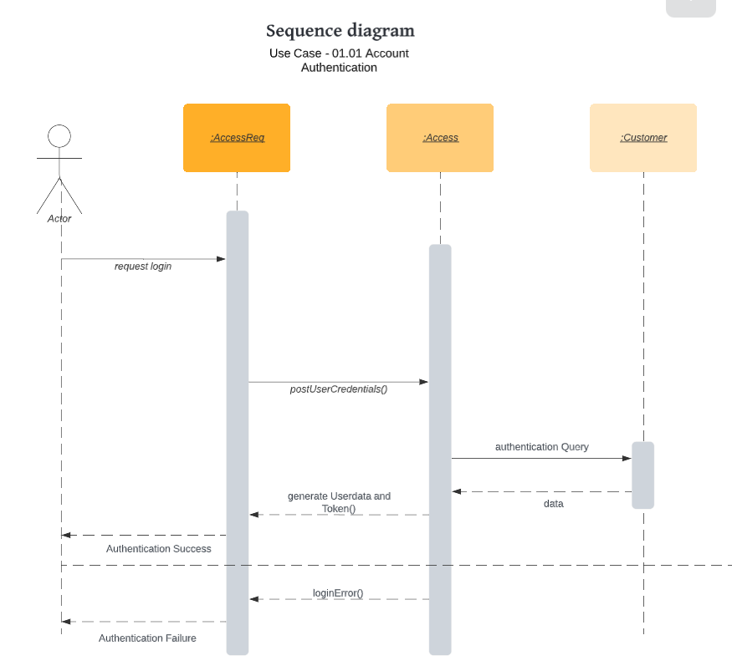
Use Case Scenario:
This Use case Begins when Actor tries to login to the system.
Actor Click on the Login Button.
System gather all the details from the database related to the actor.
Actor is allowed to Login to the application.
If System does not authorize the actor to login, Actor is not able to Login to the Application.

Slide 2
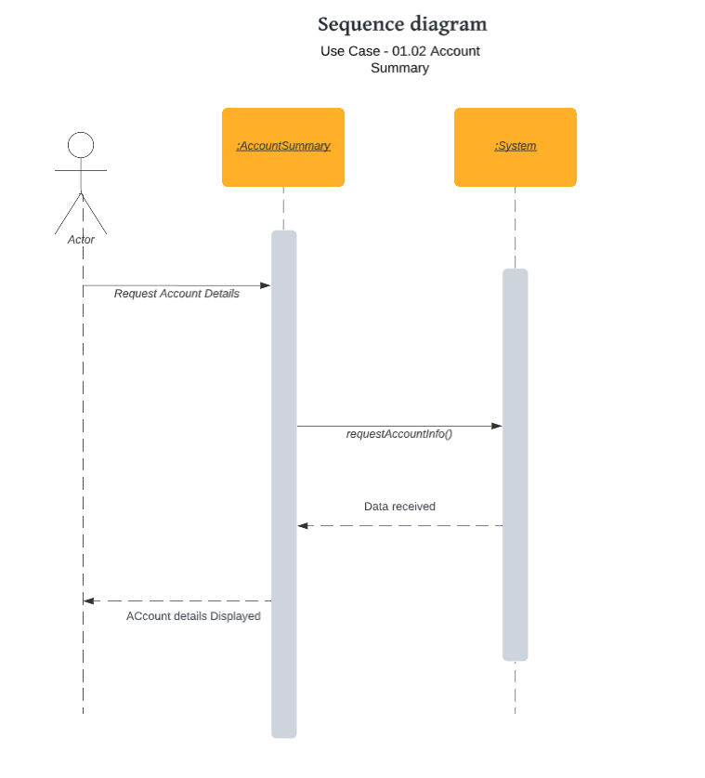
Use Case Scenario:
This Use case Begins when Actor tries to view the account summary (Edit/modify account).
Actor Click on the Edit/Modify Button.
System makes the changes according to the details provided.
Actor is able to view the profile section.
System stores the updated value in the database.
Actor can make changes to the Profile section N number of times.

Slide 3
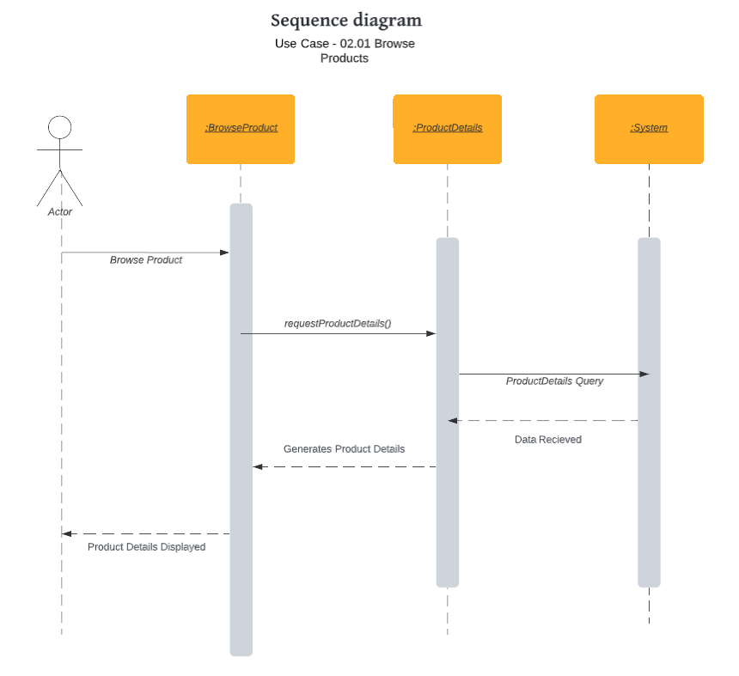
Use Case Scenario:
This Use case Begins when Actor Browse the product.
Actor search/click on the product to view.
System displays all the items related to the search option.
Actor is able to view the product details.

